Slide 1

Introduction to Hadoop
© Nihilent Technologies 2013

Slide 2
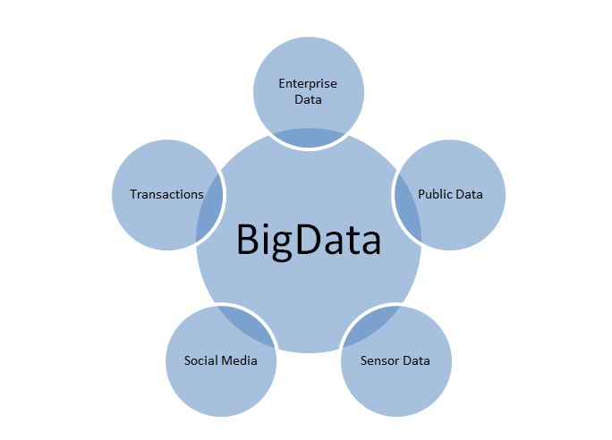
BigData : Volume, Velocity, Variety
What is BigData ?
- Twitter (over 7 TB/day )
- Facebook (over 10 TB/day)
- Google (over 20 PB/day)
- Aerial sensory technologies (remote sensing)
- Software logs, cameras(images/videos), microphones(audios)
- Radio-frequency identification readers
- Wireless sensor networks
90% of data in the world generated in just last two years.
© Nihilent Technologies 2009

Slide 3
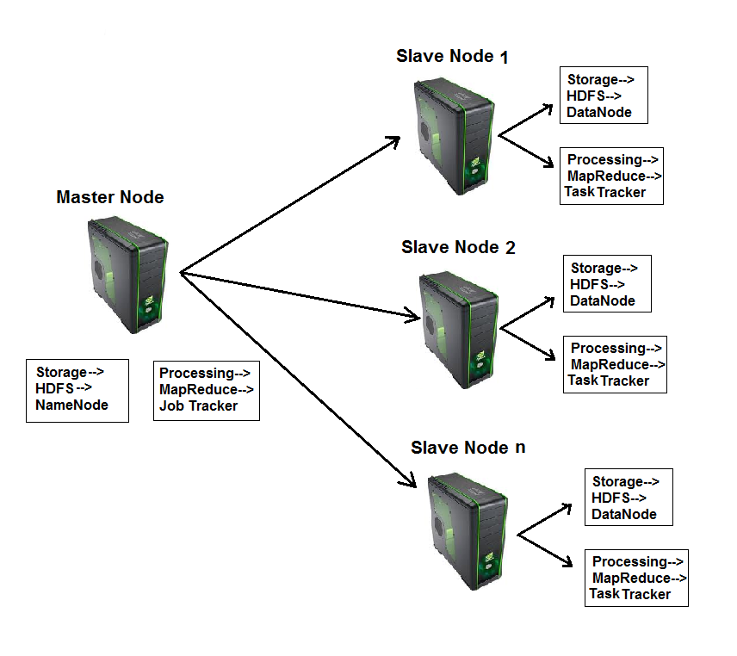
What is Hadoop?
Hadoop is a framework that facilitates functioning of several machines together to achieve the goal of storage and analyzing large sets of data.
Hadoop makes data mining, analytics, and processing of big data cheap and fast.
© Nihilent Technologies 2013

Slide 4
Components of Hadoop :
  Hadoop consists of two core components
1. The Hadoop Distributed File System(HDFS)
- HDFS is responsible for storing data on the cluster of machines.
- Data is normally split into 64MB to 128MB blocks and spread across the cluster.
2. MapReduce
      - MapReduce is data processing component of Hadoop.
      - Consist of two phases :
      1. Map
      2. Reduce
© Nihilent Technologies 2013

Slide 5
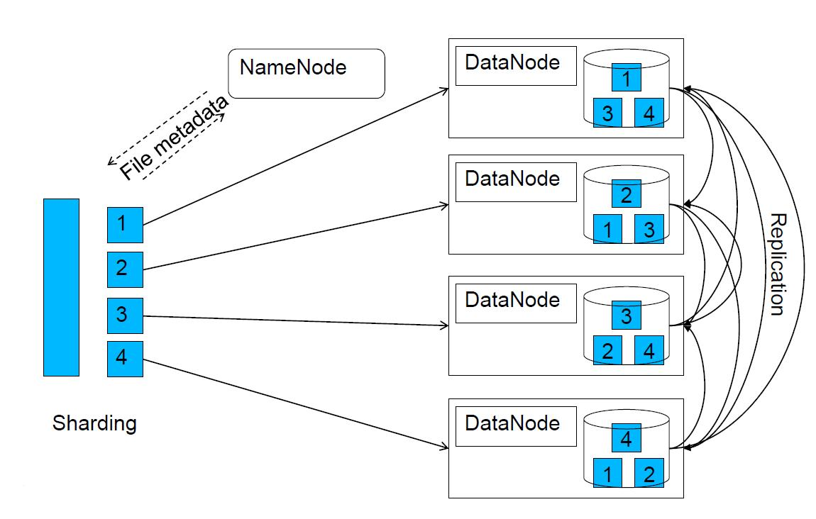
Hadoop Distributed File System(HDFS)
By default, each block(64MB to 128MB) is replicated 3 times. The replication factor can be changed through configuration settings.
© Nihilent Technologies 2013

Slide 6
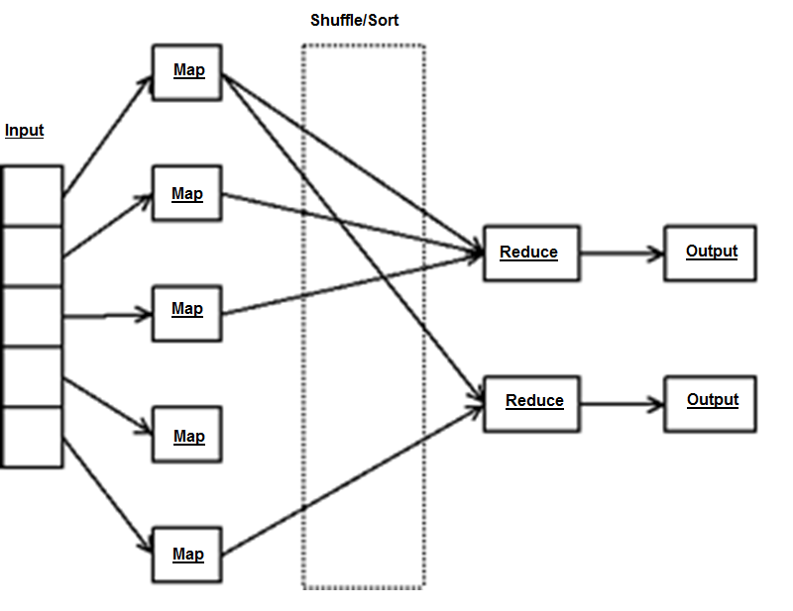
Programming Model : MapReduce
© Nihilent Technologies 2013

Slide 7
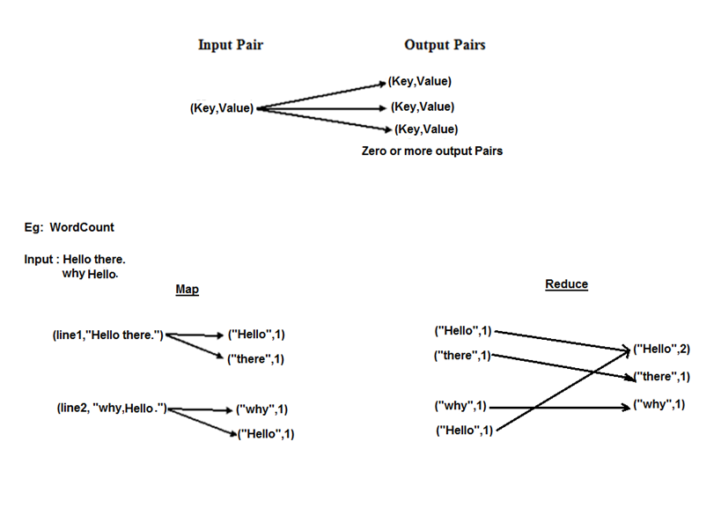
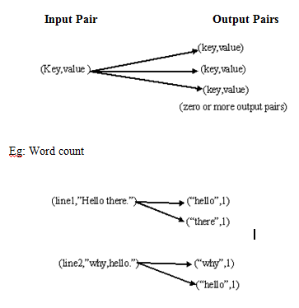
Programming Model : Key-Value Pair
© Nihilent Technologies 2013

Slide 8

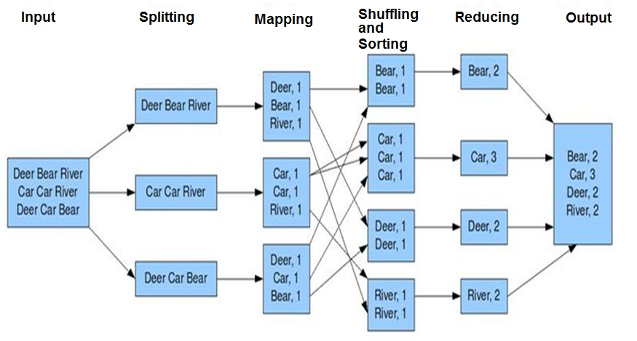
MapReduce
© Nihilent Technologies 2013

Slide 9
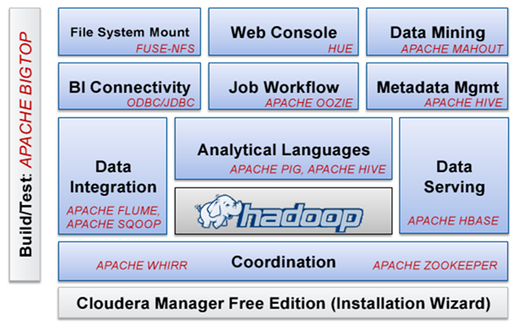
Utilities
© Nihilent Technologies 2013

Slide 10
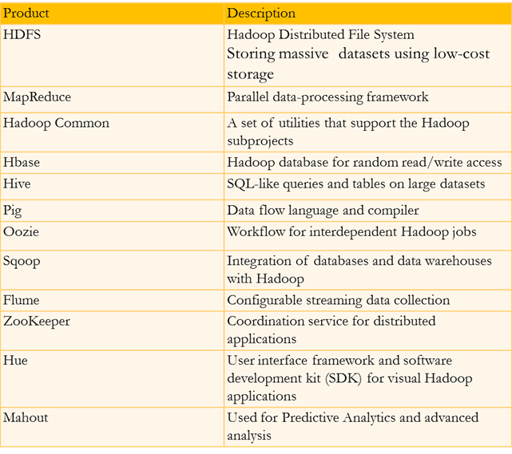
Brief description of all Utilities
© Nihilent Technologies 2013

Slide 11
Benefits of Hadoop
No huge bandwidth required.
Each node performs its task in near isolation so scaling up and down is not an issue.
Partial failure are not difficult to handle as if a node goes down, the JobTracker schedules the task on some other node without impacting the job.
© Nihilent Technologies 2013

Slide 12










Hadoop Job Processing
© Nihilent Technologies 2013

Slide 13
Demo….
Hadoop Cluster environment setup
Word Count example
MapReduce program
Operations through Hive
Operations through Hbase
© Nihilent Technologies 2013

Slide 14
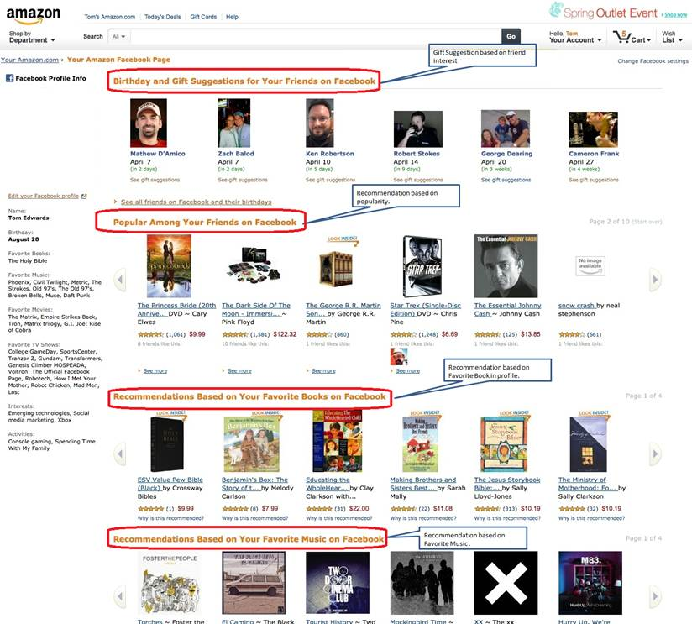
Real Time Examples: Recommendations
© Nihilent Technologies 2009

Slide 15
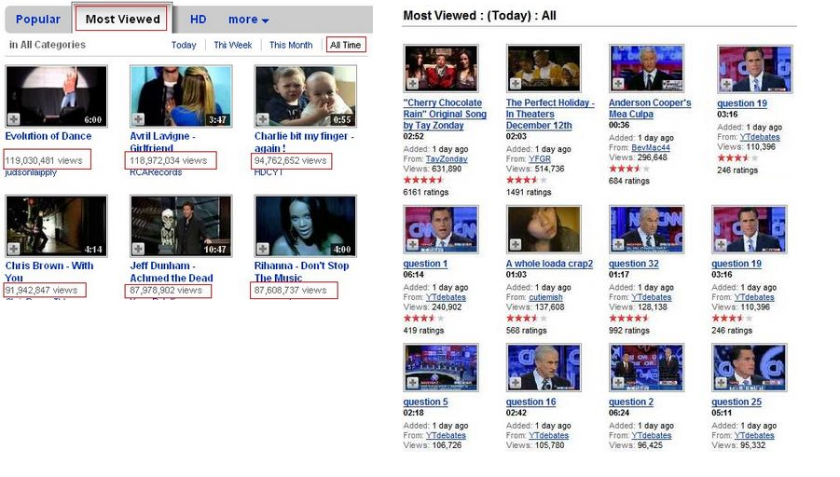
Recommendations (Continue..)
© Nihilent Technologies 2009

Slide 16
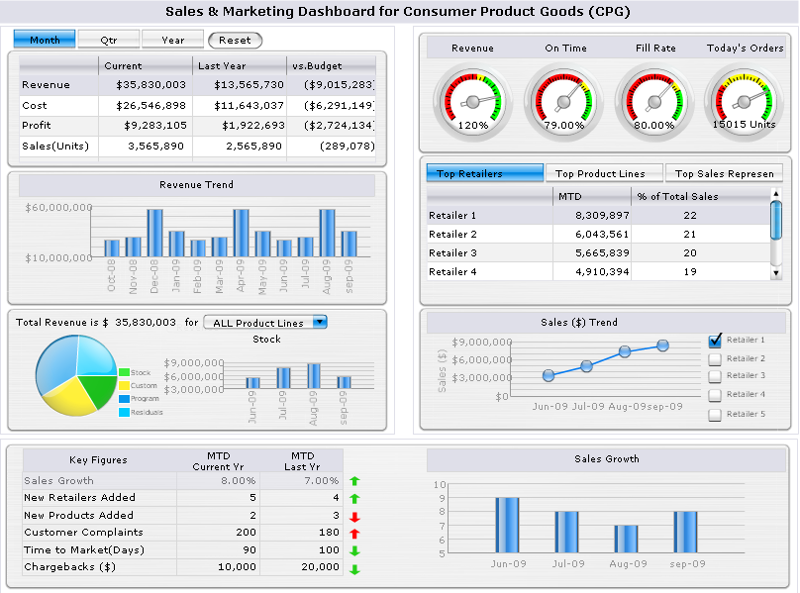
Faster Data Analysis and Reporting :
© Nihilent Technologies 2009

Slide 17

The Most Imp BigData Storage :
© Nihilent Technologies 2009

Slide 18

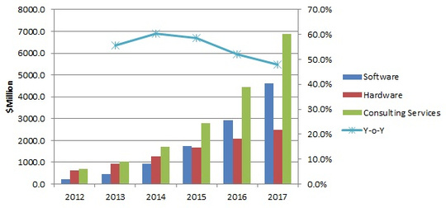
Hadoop is Growing Abnormally….
© Nihilent Technologies 2009

Slide 19
Thank You
© Nihilent Technologies 2013

